Slide 1
SI 206: Discussion 6
Working with Files and Midterm Review

Slide 2
Midterm Review

Slide 3
Functions, Strings, Conditionals, and Lists
Functions
Defined with the keyword def
Must be called to execute
Strings
String methods (str.lower(), str.upper(), str.capitalize(), etc)
String indexing and slicing
Conditionals
Execute code if a Boolean expression is true or false
if-elif-else
Logical operators (and, or, not)
Lists
Holds items in order
List methods (append, extend, pop, reverse, sort, etc)
List indexing and slicing

Slide 4
Loops, Tuples, and Dictionaries
Loops
For loop
For each item in a collection
For value in range
While loop
While some Boolean expression is true
Tuples
Immutable
Tuple indexing
Dictionaries
Hold key and value pairs
Dictionary methods(keys(), values(), items(), get(), etc)

Slide 5
Turtles
The Turtle library in Python enables us to draw many interesting shapes and designs
Turtle methods
forward(), backward(), color(), goto(), left(), right(), pendown(), penup(), pensize(), setheading(), etc
Screen methods
screensize(), bgcolor(), exitonclick(), etc

Slide 6
Terminal, Git, and GitHub
Terminal commands
cd – change directory
pwd/chdir – print current directory
ls/dir – list contents of directory
Git commands
git clone - make a copy of your remote repo on your local computer
git add – add file to your staging area
git commit – record changes in your local repo
git push – send your committed local changes to a remote repo (GitHub)
git status – where you can see what is staged for a commit, what has changed but not staged, and what is ignored

Slide 7
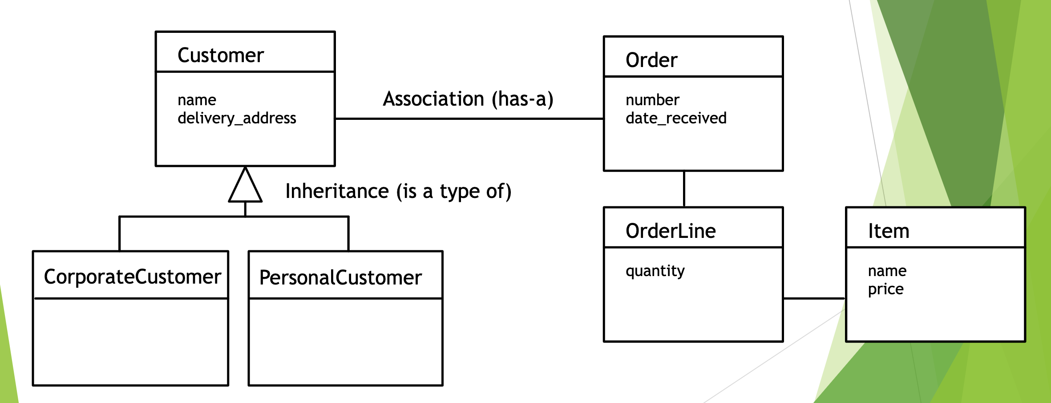
Classes and Objects
Class: defines what all objects of the class know (attributes) and can do (methods)
Object: an instance of a class
Inheritance: one class can inherit from another
Association: one class can be associated with another

Slide 8
Unit Tests
Import unittest
Make a subclass of unittest.TestCase
Define methods for test cases
Start each method with test_
Use assertion methods (ex: assertEqual()) to check the results
Run the tests using unittest.main
Test cases
Test usual values
Test edge cases

Slide 9
Working with Files
open: opens a file for reading or writing
close: closes a file after you are finished with it
read: reads all data from a file and returns a string
write: writes to a file

Slide 10
Discussion 6 Exercise

Slide 11
CSV Format
CSV (comma separated values) files are a simple and lightweight way to store structured data. They can be read by many different programs and are a common format for sharing datasets.
A CSV file represents data as a series of rows and columns, much like an Excel spreadsheet or a matrix.
The first row of a CSV usually contains the name of each column. This is called the header row. Most CSVs have one, but it isn’t required.
Each line of a CSV represents a row. Usually the columns are separated from each other using commas (,) within each row, unless specified otherwise.
Other separators such as tabs (\t) and pipes (|) can be used, but commas are by far the most common.

Slide 12
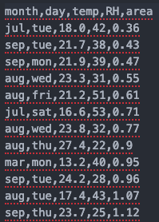
Example CSV data
Header
(Note that the columns are only separated with commas. There is no need for additional spaces between commas.)

Slide 13
Newline Characters (\n)
When we open a CSV file in a program like Excel or an IDE like VSCode, the rows are automatically placed onto their own line for readability.
However since computers don’t have eyes, they need to use a special character called a newline to know where one line should end and one should begin.
A newline character is represented in Python as ‘\n’ and it counts as a single character. (i.e. len(‘\n’) == 1 would return True)
You won’t need to worry about this for today’s assignment, but it’s good to be aware of this.

Slide 14
Today’s Assignment
We will be working with a dataset of Forest Fires
The adapted dataset contains the following columns:
month - month of the year: 'jan' to 'dec'
day - day of the week: 'mon' to 'sun'
temp - temperature in Celsius degrees: 2.2 to 33.30
RH - relative humidity in %: 15 to 96
area - the burned area of the forest (in hectares): 0.09 to 1090.84

Slide 15
Your Task
In the starter code you are given a class, FireReader and several methods to implement
FireReader reads in the CSV file and builds a dictionary where each key is the name of a column, and each value is a list of the data in that column. The dictionary is stored in an instance variable called data_dict
self.data_dict = {
‘month’: [‘jul’, ‘sep’, ‘sep’...],
‘day’: [‘tue’, ‘tue’, ‘mon’...],
‘temp’: [18.0, 21.7, 21.9…],
‘RH’: [42, 38, 39…],
‘area’: [0.36, 0.43, 0.47...]
}
becomes

Slide 16
Your Task
First, you’ll need to fix the bugs in the build_data_dict() method
HINT: Think about the header row and how columns are separated in CSVs
Then you’ll need to implement each method of the FireReader class according to the instructions in the starter code.
We have provided several test cases for you that should pass if you’ve completed the assignment successfully; please don’t change any of these test cases

